Slide 1
Map, Food, & Smiles
Huei-Wen Teng, 鄧惠文
20240419 TEN MFS.key

Slide 2

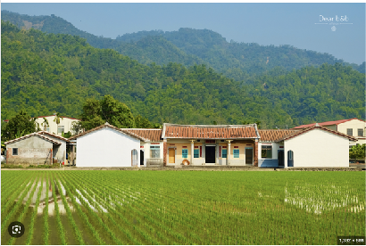

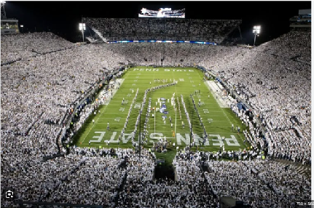
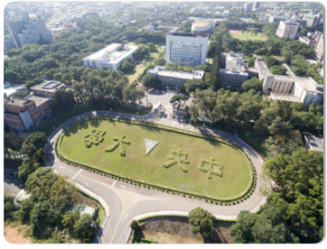
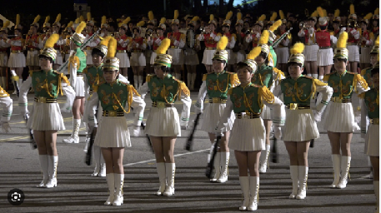

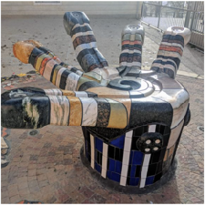
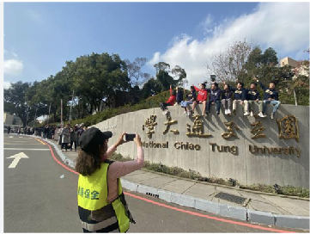
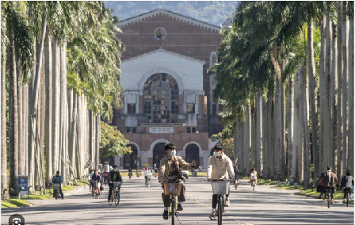
Maps
1979: Taoyuan, TW
2005-2010: Beaver Stadium, PSU, PA, USA
2010-2017: NCU
1994-1997: TFG
2001 Fall: Linz, Austria
2017-present: NYCU
1997-2001 math, 2002-2004 finance: NTU
Title

Slide 3
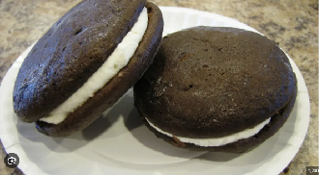
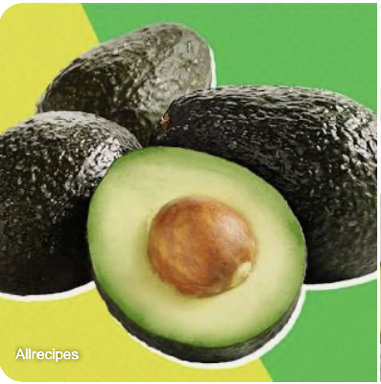
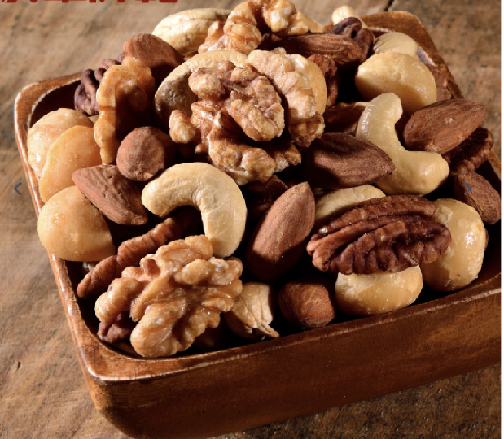
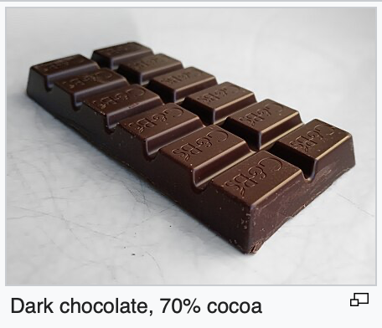
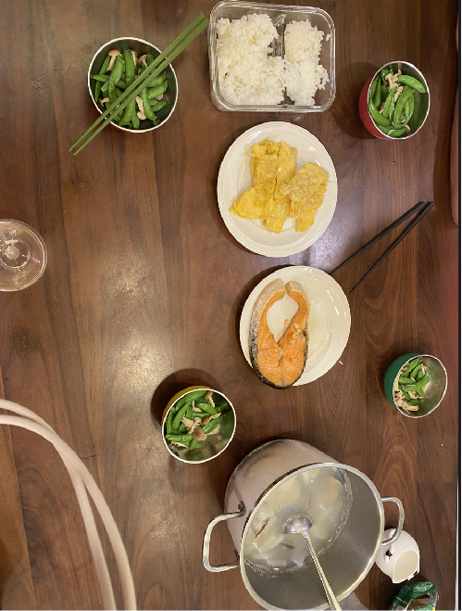


Food
Woopie Pie
Cooking dinner for kids
Title

Slide 4

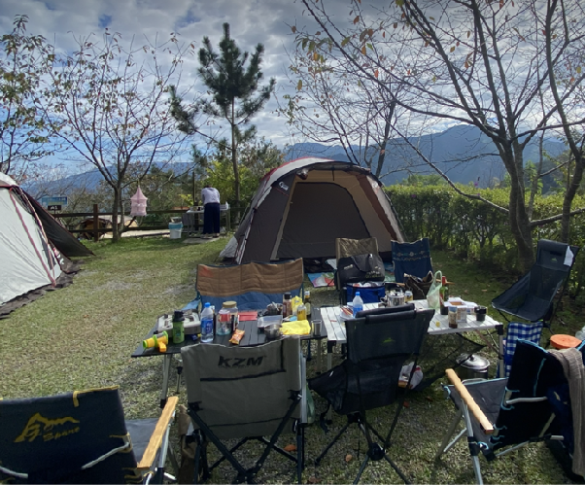

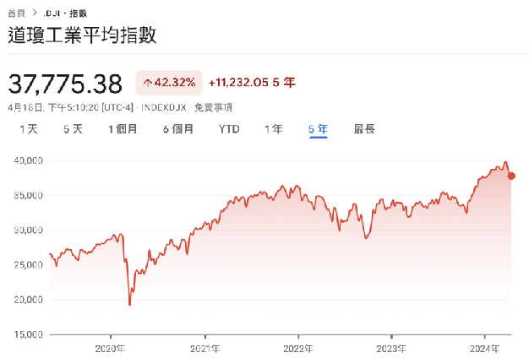
Smiles
Sun Moon Lake
Camping
Investment
Human evolution
Title

Slide 5
Map, Food, Smiles
T2
20240419 TEN MFS.key

